Slide 1
Home Financing Assignment
Step-by-Step Guide

Slide 2
Instructional Reminders
This is an individual assignment. Assignment submissions which are not unique will be considered in violation of the Academic Honesty Policy
Provided table templates are required for assignment completion – alternate formats are not accepted
The entirety of the three tables are to be completed and a property listing included
Submissions made be made in a single comprehensive, or multiple file, attachments
Submissions must be made over Blackboard and are not accepted over email
Timely and accurate submission, as well as navigating Blackboard, is considered part of the assignment
Submission files must be in PDF format. Submitted files which cannot be opened, will not be graded. Please review your submission in the My Grades Blackboard tool.

Slide 3
Assignment Overview
Objective:
The purpose of this assignment is to familiarize students with the process of budgeting for the purchase and financing of a home, or another significant financed purchase, as well as building awareness of key factors not to be overlooked throughout this process.
Overview: This assignment is comprised of four parts:
Selecting a Property Goal
Students must select, and secure a copy of, a current property listing which is representative of a real estate investment goal they may wish to pursue.
Budgeting for your Goal
Students must perform several calculations to determine the total transaction costs, including both the down payment and closing costs, that will be required in order to purchase the home they have selected. Variations on these calculations will explore the effects of making financial planning adjustments
Evaluating Financing Options
Students must examine the advertised mortgage options available through various financial institutions, considering several financing contract factors, in order to finance the remaining cost of the home. Various financing options will help expose the impacts of different mortgage factors
Paying Off the Mortgage
Finally, applying data collected, previous decisions made and incorporating some additional considerations, students must calculate the corresponding monthly mortgage payments by using an online mortgage calculator. Variations on these calculations will explore the effects of making financial planning adjustments.

Slide 4
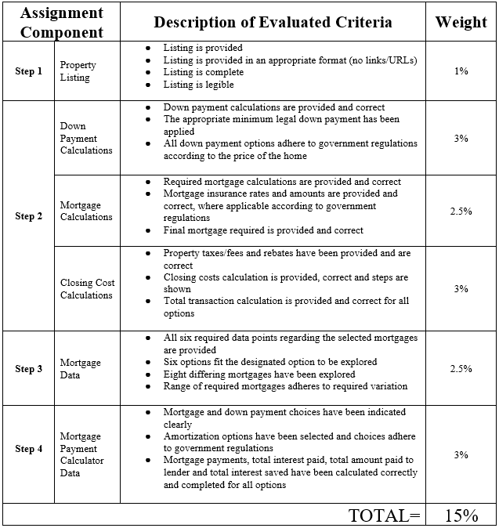

Slide 5
Step 1: Selecting a property goal
Students must select, and secure a copy of, a current property listing which is representative of a real estate investment goal they may wish to pursue

Slide 6
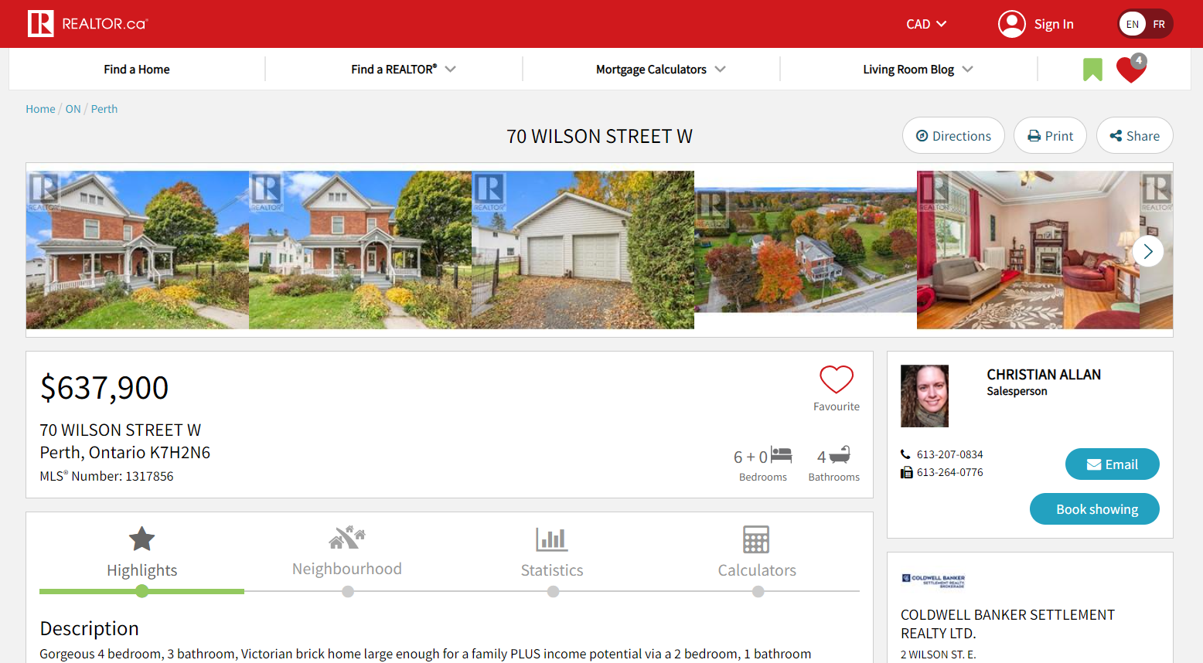
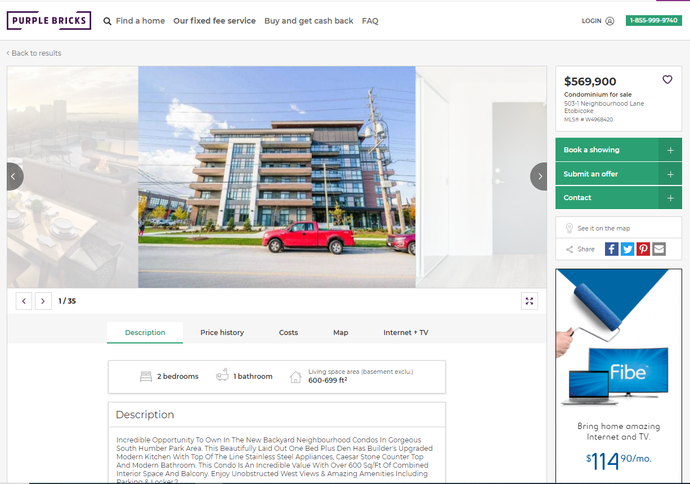
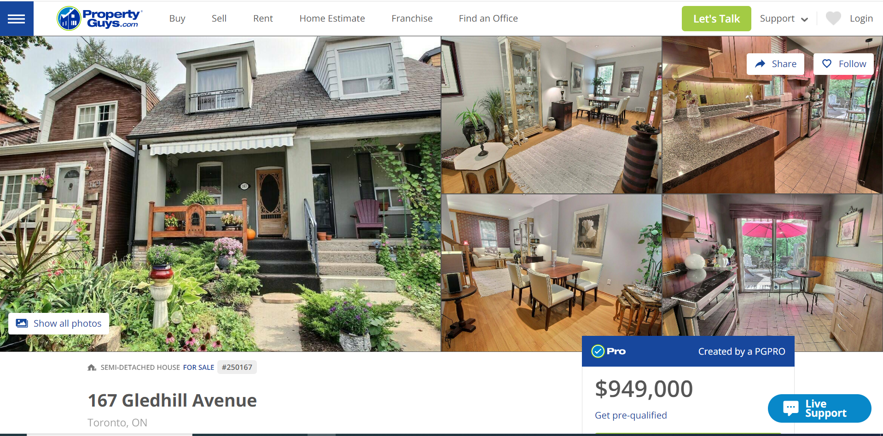
Selecting a Property Goal
Students must secure a copy of a real estate listing (screen capture). This copy must be easily legible and contain a minimum of the following details:
Price of home
Type of home
Location of home
Size of home
Picture of home
Links or URLs are NOT an acceptable format for submitting the property listing as the listing may close before the assignment is complete and the listing information is then inaccessible.
Students are encouraged to select a property that aligns as closely as possible with their real life property ownership goals. Therefore the criteria is quite flexible:
The property can be anything from a house, to a condo, to a mobile home or even a piece of land for later development
There is no maximum or minimum price, but attainable and desirable for your lifestyle should be considered guidelines – consider starter vs dream homes
The house may be located anywhere, so long as all information for the completion of the assignment can be obtained and submitted in English.
Some places to locate Canadian property listings include:
https://www.realtor.ca/mls
https://propertyguys.com/
https://purplebricks.ca
There are many other property listing sites so feel free to browse!
Examples of acceptable “captured” property listing information

Slide 7
Step 2: budgeting for your goal
Students must perform several calculations to determine the total transaction costs, including both the down payment and closing costs, that will be required in order to purchase the home they have selected
Variations on these calculations will explore the effects of making financial planning adjustments

Slide 8
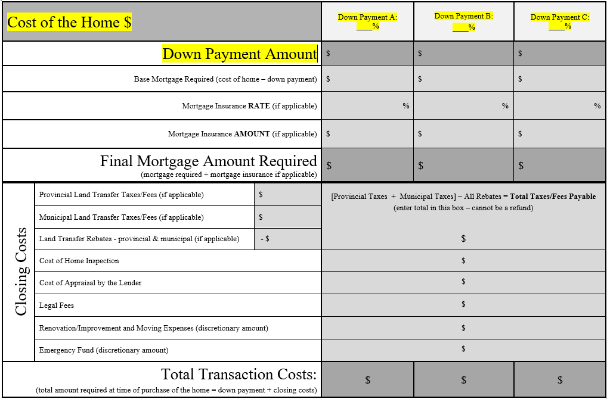
Budgeting for your Goal
A table has been provided which must be used in presenting all required data for Step 2
Begin by noting the following information:
Cost of Home: total amount home is listed for
Now explore three down payment options:
Down Payment: this is your equity towards the cost of the home. Equity is the value of an asset you own - this doesn’t include any portion that is borrowed (the mortgage)
The down payment is captured in the table as both a % of the purchase price AND the dollar amount this represents
Please refer to the class slides & textbook for more details on the legal guidelines for a down payment as all three options explored must abide by legal guidelines
You are asked to explore three down payment variations:
Down Payment A = minimum legal down payment for this property
Down Payment B = 20% Conventional Mortgage OR if Down Payment A is 20%, then an alternate down payment option of your choice
Down Payment C = alternate down payment option of your choice (must differ from two previous and be legally viable)
*Highlighted areas relate to instructions given on this page

Slide 9
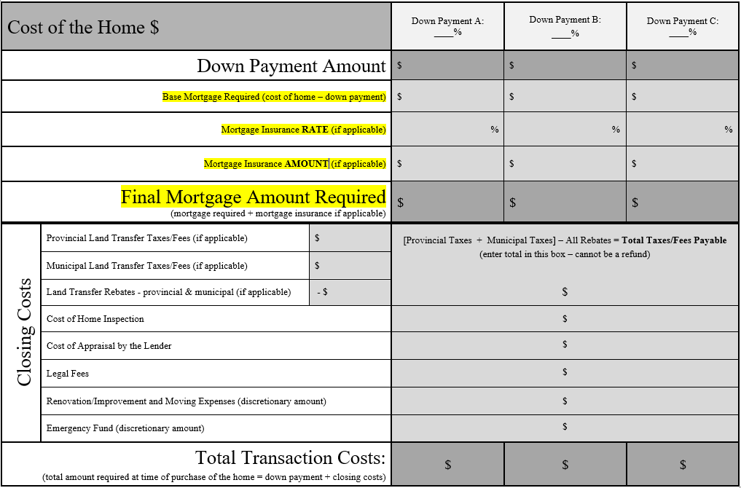
Budgeting for your Goal
Now, calculate the base mortgage required for each down payment option:
Base Mortgage Required: portion of the home price which you must borrow.
Cost of Home - Down Payment Amount = Base Mortgage Required
Factor in Mortgage insurance, where applicable:
Mortgage Insurance: this is required if your down payment is less than 20% of the cost of the home and this expense is added onto the mortgage amount. Consider government regulations (noted in slides/textbook) regarding each of the three down payment amounts.
Mortgage Insurance rates and amounts can be calculated at the following tool link:
https://www.cmhc-schl.gc.ca/en/finance-and-investing/mortgage-loan-insurance/homebuying-calculators/mortgage-calculator
Please note: this tool requires you to enter additional information such as the interest rate of the mortgage which you may have not selected at this point in the assignment. However, those numbers will not affect the mortgage insurance rate and cost which is what you are seeking at this time. So, simply enter any value for the unknowns in order to proceed with the tool.
The two factors which affect the mortgage insurance rate to be paid are the cost of the home and amount of the down payment.
Calculate the complete total you will be financing/borrowing:
Final Mortgage Amount Required: finalized total for the mortgage required
Base Mortgage + Mortgage Insurance Amount = Final Mortgage Amount Required
This amount will be required in step 5, but for now return to the other costs associated with the initial purchase of the home…
*Highlighted areas relate to instructions given on this page

Slide 10
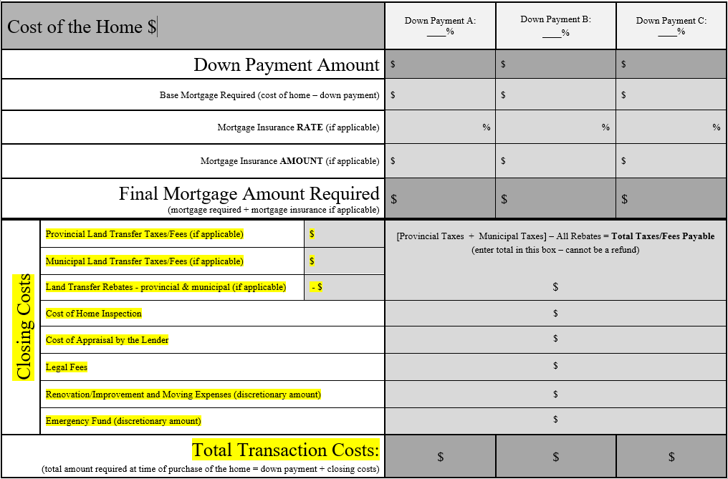
Budgeting for your Goal
Beyond the down payment, there are other costs associated with the initial purchase of the home:
Closing Costs: additional costs that must be paid around the time of purchase. These costs represent an additional expense that must be budgeted for and paid when purchasing a home - they are in addition to the cost of the home and separate from the mortgage.
Land Transfer Tax (or registration fee): a significant closing cost paid on most homes to the government, calculated according to value and location of the home, as well as rebates offered.
If the home is in Canada, this link below will help you calculate the amounts for both taxes/fees and rebates that are applicable at the provincial level as well as for the GTA:
https://www.ratehub.ca/land-transfer-tax
If the property is outside of Canada you must research the applicable taxes/fees and provide a reference source for your estimate.
Although the relevant costs and types of fees vary, for the purpose of the assignment, other closing costs can be budgeted at or above the following estimates:
Home Inspection Fee = $500
Appraisal Fee = $450
Legal Fees and Disbursements = $800
Renovations/Improvements and Moving Costs = your discretionary choice!
Emergency Fund (additional unexpected expenses) = your discretionary choice!
The final step of budgeting is to add up the total amount of money you will need around the time of purchase of the property:
Total Transaction Costs: total amount of money you need at time of purchase (outside of the mortgage). You will explore this for all three down payment options.
Down Payment Option + Various Closing Costs = Total Transaction Costs
Review the three options you have explored and select one to carry forward working on in Step 4…
*Highlighted areas relate to instructions given on this page

Slide 11
Step 3: evaluating financing options
Students must examine the advertised mortgage options available through various financial institutions, considering several financing contract factors, in order to finance the remaining cost of the home
Various financing options will help expose the impacts of different mortgage factors

Slide 12
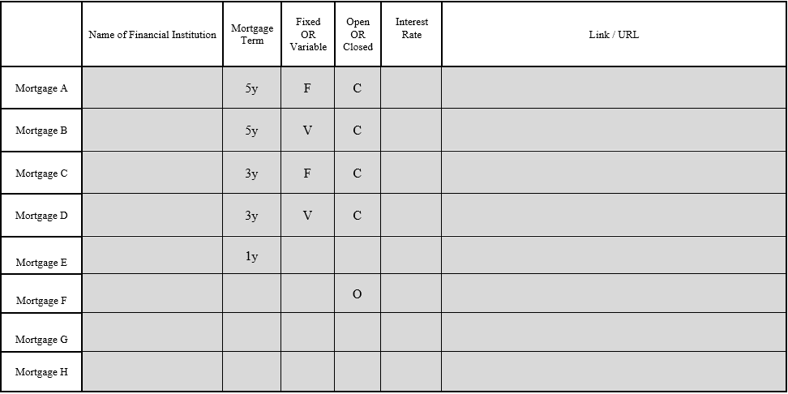
Evaluating Financing Options
A table has been provided which must be used for the completion of Step 3
The following data must be recorded for Eight mortgage options with variations according to requirements noted below:
Name of financial institution - minimum of three institutions explored
Mortgage term - minimum of three different terms lengths explored
Fixed or variable - one of each must be explored
Open or closed - one of each must be explored – if not noted, assume that it is closed as that is the default
Interest Rate – note that with variable mortgages this may be referred to as the initial rate
Link/URL or screen shot of web page of financial institution which advertises this mortgage
The first six rows have been pre-determined and so seek out a mortgage which fits these exact conditions and note the remaining data. If an exact match cannot be found, substitute an option which is as close as possible
The final two rows are free choices and may explore any variation of conditions
ALL rows are to be completed
Consider investigating:
Official websites of banks, brokers and other financial institutions
Mortgage comparison sites (rate accessible without offering email account or ‘applying’) such as:
https://www.lowestrates.ca/mortgage
https://www.ratehub.ca/mortgages
https://www.ratesupermarket.ca/mortgages
Review the eight options you have explored and select one to carry forward working on in Step 4…

Slide 13
Step 4: Paying off the mortgage
Finally, applying data collected, previous decisions made and incorporating some additional considerations, students must calculate the corresponding monthly mortgage payments by using an online mortgage calculator
Variations on these calculations will explore the effects of making financial planning adjustments

Slide 14
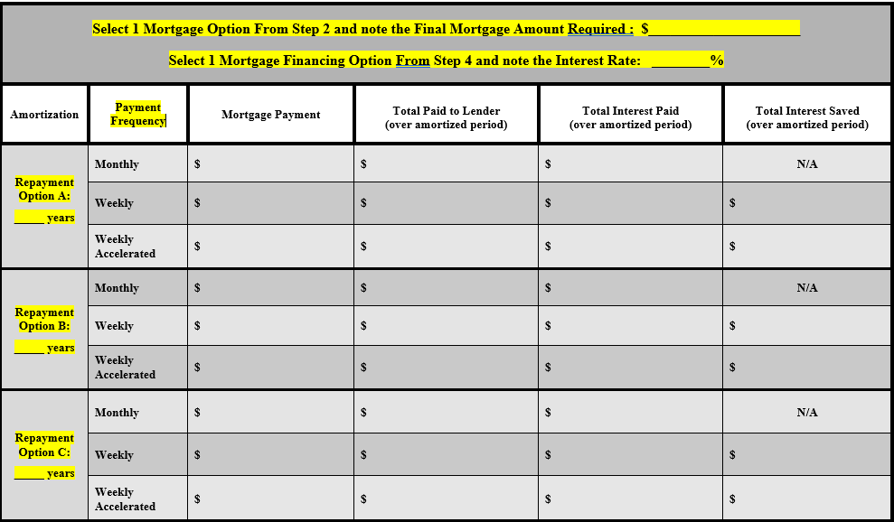
Paying Off the Mortgage
Once more a table has been provided which must be used for the completion on step 4
Refer back to previous steps to select and note the following:
Select 1 Final Mortgage Amount Required from step 2
Select 1 Interest Rate from options in step 3
Next, you must account for:
Amortization: this is the length of time you are spreading your debt re-payment over.
Please refer to the class slides & textbook for more details on the legal guidelines for a mortgage amortization as all three options explored must abide by legal guidelines
There are three options to be explored:
Amortization A = legal maximum amortization for this mortgage
Amortization B = alternate option of your choice (must differ from others)
Amortization C = alternate option of your choice (must differ from others)
The final factor in the calculation will be:
Payment Frequency: this is the frequency of the mortgage payments made to repay the debt.
You are required to explore each of the following standard payment frequency options for each of the amortization periods:
Monthly Payments
Weekly Payments
Accelerated Weekly Payments
*Highlighted areas relate to instructions given on this page

Slide 15
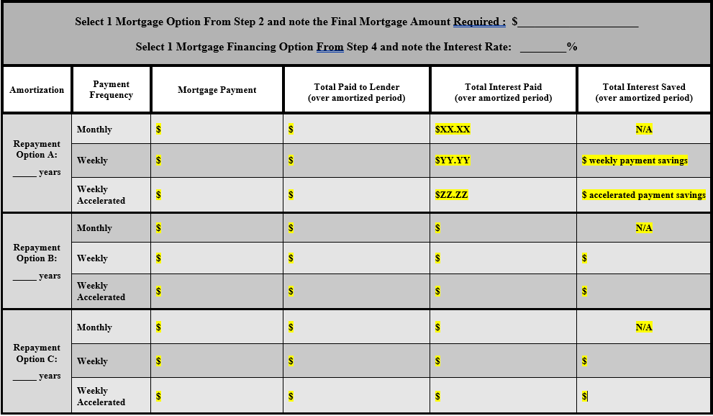
Paying Off the Mortgage
Calculate your mortgage payments as well as numbers relating to the full length of the mortgage:
Use a Canadian mortgage calculator. This one is recommended as it considers all listed factors and provides all required results:
https://www.cchwebsites.com/content/calculators/CAMortgageLoan.html
*this calculator ask you the enter mortgage term as well but it will have no effect on the results requested*
Canadian mortgages are regulated to limit interest compounding to semi-annually, which will differ from payment frequency. Accounting for this difference adds a level of complication to the annuity formula that is beyond what we have studied in class, meanwhile mortgage calculators make easy work of this and are a practical tool. Be sure to use a Canadian mortgage calculator.
You will mix and match the 3 amortization options and the 3 possible payment frequencies to see what impact these factors have on the value of the mortgage payment and the amount of interest to be paid on the mortgage.
For each variation you must record the following:
Mortgage Payment for the period
Total Paid to Lender or Total Payments (the total amount given to the lender if the mortgage conditions were maintained for the full amortization period, not just the term)
Total Interest Paid (the total interest paid to the lender if the mortgage conditions were maintained for the full amortization period, not just the term)
Total Interest Saved (while monthly payments pay the full amount of interest, none saved, the other two options will reveal interest saved due to that different payment frequency)
The mortgage calculator tool will provide the answers to the first three columns. The fourth column, “Total Interest Saved” must be calculated by subtracting ‘Total Interest Paid’ with each of the other two options from ‘Total Interest Paid’ with the monthly payment frequency (this is the benchmark as no interest is saved with monthly payments)
Example using table shown: $XX.XX – $YY.YY = weekly payment savings $XX.XX – $ZZ.ZZ = accelerated payment savings
*Highlighted areas relate to instructions given on this page AND example

